Slide 1
Iterative Improvement and Maximum-Flow Problem
Greedy techniques iteratively construct an optimal solution by building optimal solutions from smaller problems. Iterative improvement techniques build an optimal solution by iterative refinement of a feasible solution for the complete problem.

Slide 2
Maximum Flow Problem

Slide 3
The Maximum flow problem involve finding a feasible flow through a single source, single sink flow network that is maximum.

Slide 4
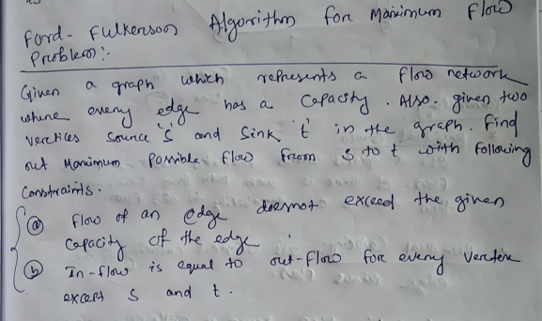

Slide 5
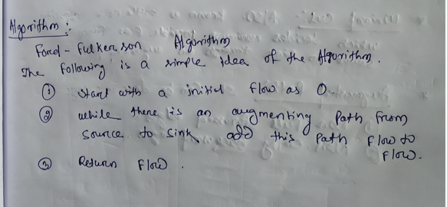

Slide 6
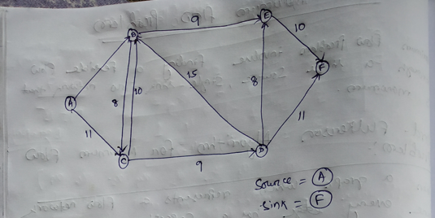

Slide 7
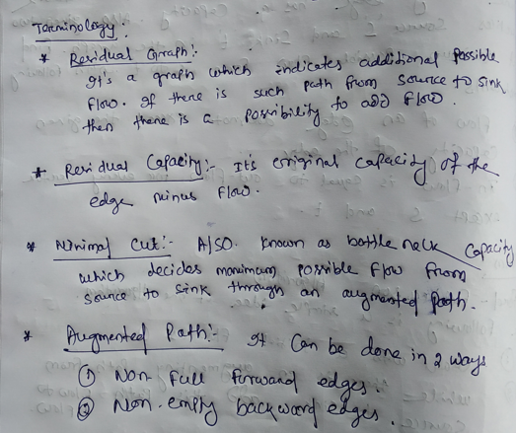

Slide 8
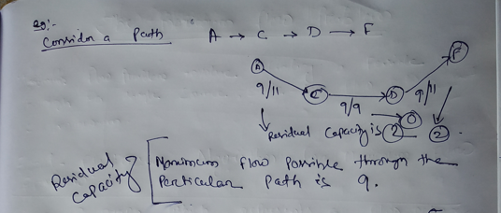

Slide 9
